Slide 1
Introduction to safecom
May 2023

Slide 2
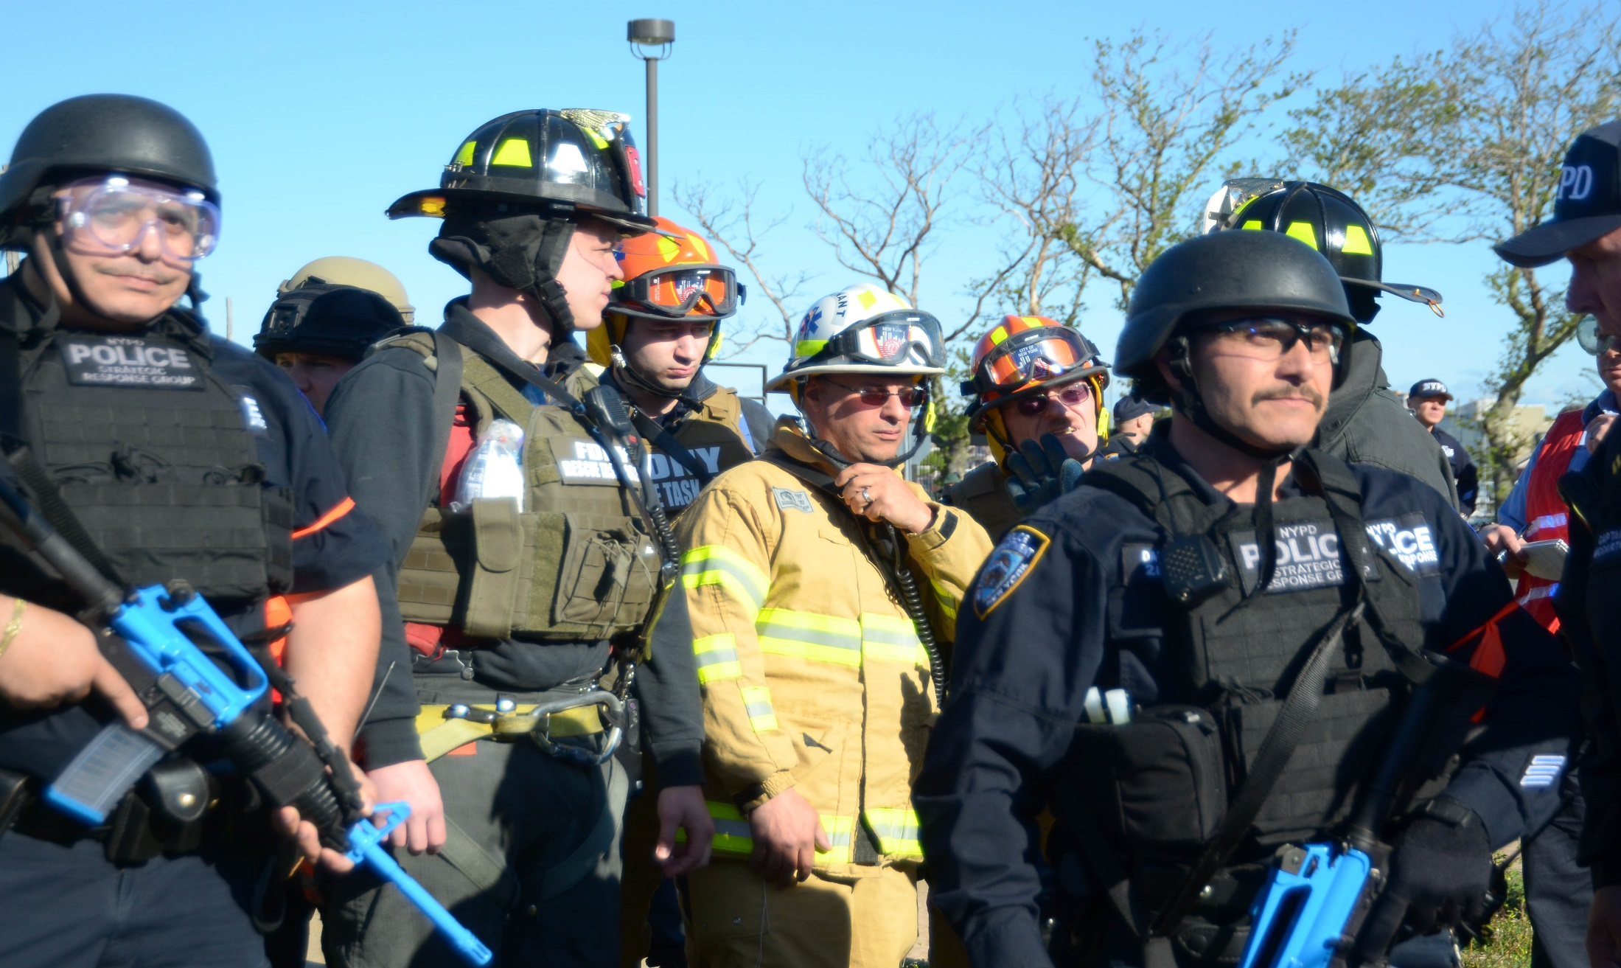
What is SAFECOM?
    SAFECOM was formed in 2001 after the terrorist attacks of September 11, 2001, to improve multi-jurisdictional and intergovernmental communications interoperability
Notes:
We all remember the events of September 11, 2001, and the impact they had on our country. While there may be no way to completely prevent another attack, we can use the lessons we learned from that day to better prepare for emergencies and disasters.
Understandably, many assume responders—no matter their agency, discipline, or geographic boundary—are able to communicate with each other during day-to-day and out-of-the-ordinary incidents. After all, timely communications during critical events is often a matter of life or death.
However, despite advances in modern communications, emergency responders often still struggle to communicate effectively with members of their own agencies, let alone agencies in neighboring states, counties, cities, localities or tribal communities. Unfortunately, this became clear as thousands of emergency services personnel converged on the scenes in New York City; Washington, DC; and Shanksville, Pennsylvania, to respond to the attacks of September 11.
The response to those attacks identified major gaps in the public safety community’s ability to talk to one another and share information when necessary—or to interoperate. Although an accurate description of SAFECOM’s original intent and impetus for its formation, this is an overly-simplified end goal to more complex issues—standardized processes, operational procedures, and a common language; a way for different brands of communication equipment to speak to one another; an agreed-upon command structure; and practices in place for building collaborative relationships across those likely to coordinate during large-scale events.
In an effort to resolve major communications issues identified during the September 11, 2001, terrorist attacks, SAFECOM was created as a Presidential E-Government Initiative to improve interoperability, allowing emergency responders to communicate more effectively before, during, and after emergencies and disasters.
SAFECOM’s mission is “improve emergency response providers’ inter-jurisdictional and interdisciplinary emergency communications interoperability across local, regional, tribal, state, territorial, international borders, and with Federal government entities.” (SAFECOM Charter)
SAFECOM functions as an advisory body to and is administered by the Cybersecurity and Infrastructure Security Agency (CISA). The group produces guidance to achieve operable and interoperable communications across agency, disciplinary, and governmental borders as well as provides feedback to the Department of Homeland Security (DHS) Science and Technology Directorate (S&T) as part of research and development efforts as well as the Federal Emergency Management Agency (FEMA) for emergency communications grant guide.
It is one of the first organizations to bring together elected and appointed officials, representatives from public safety associations, and emergency responders in the field to promote governance, best practices, and lessons learned related to emergency communications.
(For reference) I bet some of you are wondering what SAFECOM stands for. SAFECOM is actually NOT an acronym as many first assume. The E-government Initiative addresses this program as the “Wireless Public Safety Interoperable Communications/Project SAFECOM.” However, it is more commonly referred to as SAFECOM.

Slide 3
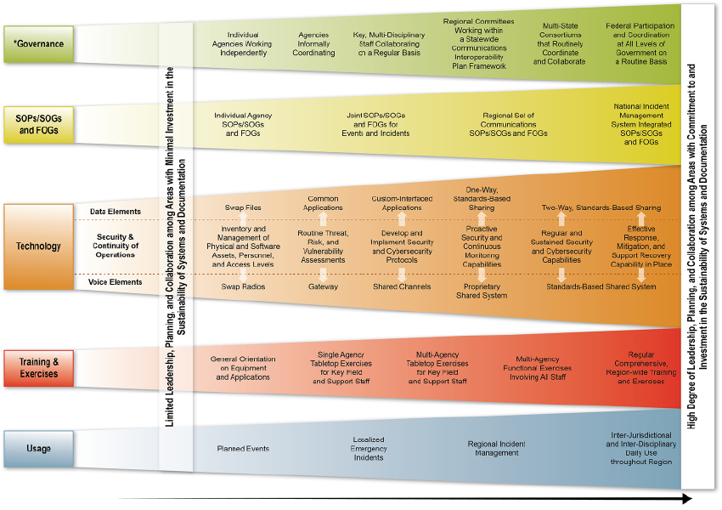
What is Interoperability?
SAFECOM Interoperability Continuum
Notes:
Provide brief description of interoperability (see notes below for reference)
The National Emergency Communications Plan (NECP), defines interoperability as “the ability of public safety responders to share information via voice and data communications systems on demand, in real time, when needed, and as authorized.”
In response to the lack of interoperability among agencies during 9/11 SAFECOM, in a collaborative effort with the CISA and DHS S&T developed the Interoperability Continuum.
The Interoperability Continuum was designed as a tool to assist emergency response agencies and policy makers with planning and implementing interoperability solutions for data and voice communications. This tool identifies five critical success elements that must be addressed to achieve a sophisticated interoperability solution: governance, standard operating procedures (SOPs), technology, training and exercises, and usage of interoperable communications. Jurisdictions across the Nation can use the Interoperability Continuum to track progress in strengthening interoperable communications. For instance,
The Continuum shows the evolution of communications and challenges of emergency response that must be addressed to be successful
Even through new technology, such as broadband, social media, or next generation 9-1-1, come in to play, the continuum remains the guide for continuing to address the sustainment of land mobile radio and the integration of new and emerging technologies
SAFECOM uses the Continuum to identify problem areas to explore and coordinates with existing federal communications programs, elected and appointed officials, and key emergency response stakeholders to improve processes and policy of existing communications systems and future networks
The SAFECOM Interoperability Continuum is currently undergoing revisions through SAFECOM
[Presenter should create bullets on their experiences with the continuum in action:
Explain the real world situation
Identify how the continuum worked for you in the situation to improve emergency communications
Describe the outcome]

Slide 4
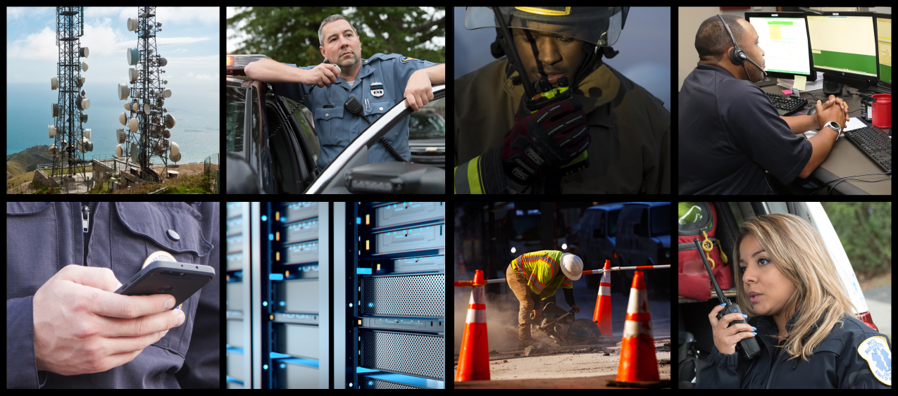
SAFECOM’s Value
    SAFECOM, as an advisory body to CISA, aims to improve public safety communications operability, interoperability, and security across local, regional, tribal, state, territorial, international borders, and with Federal government entities
    SAFECOM’s unique blend of members and institutional knowledge lend significant credence to SAFECOM’s products

Slide 5












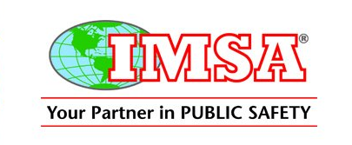
























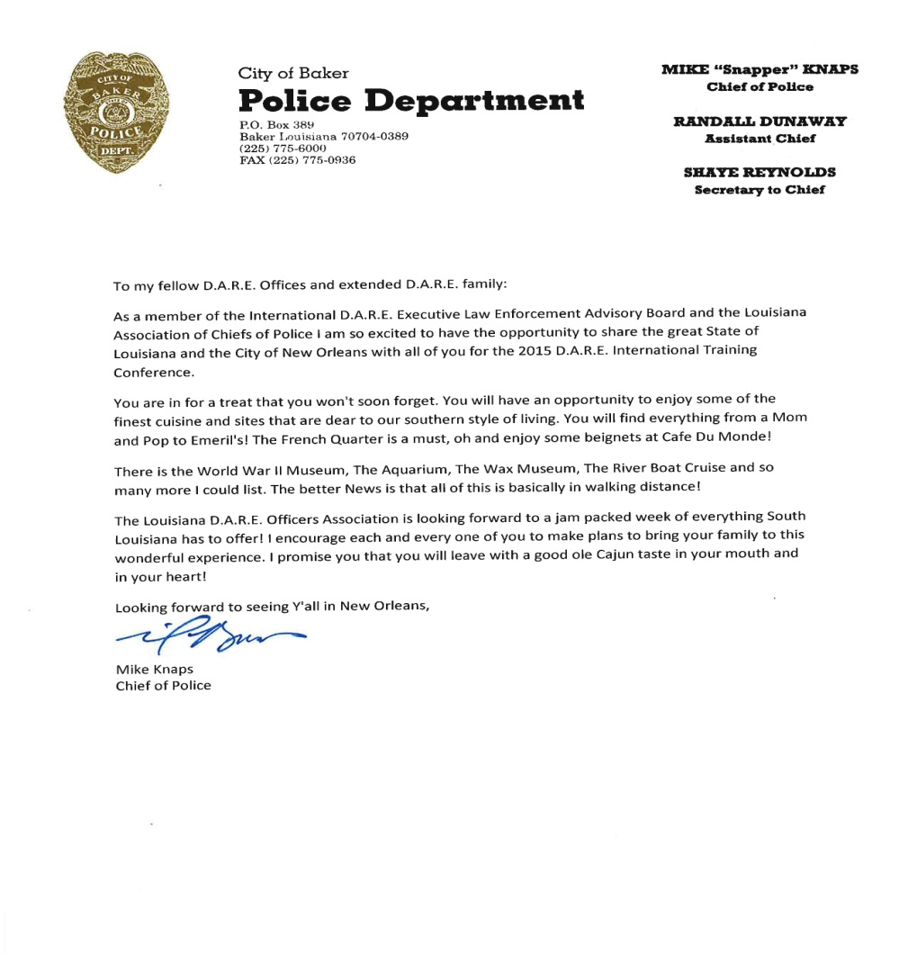






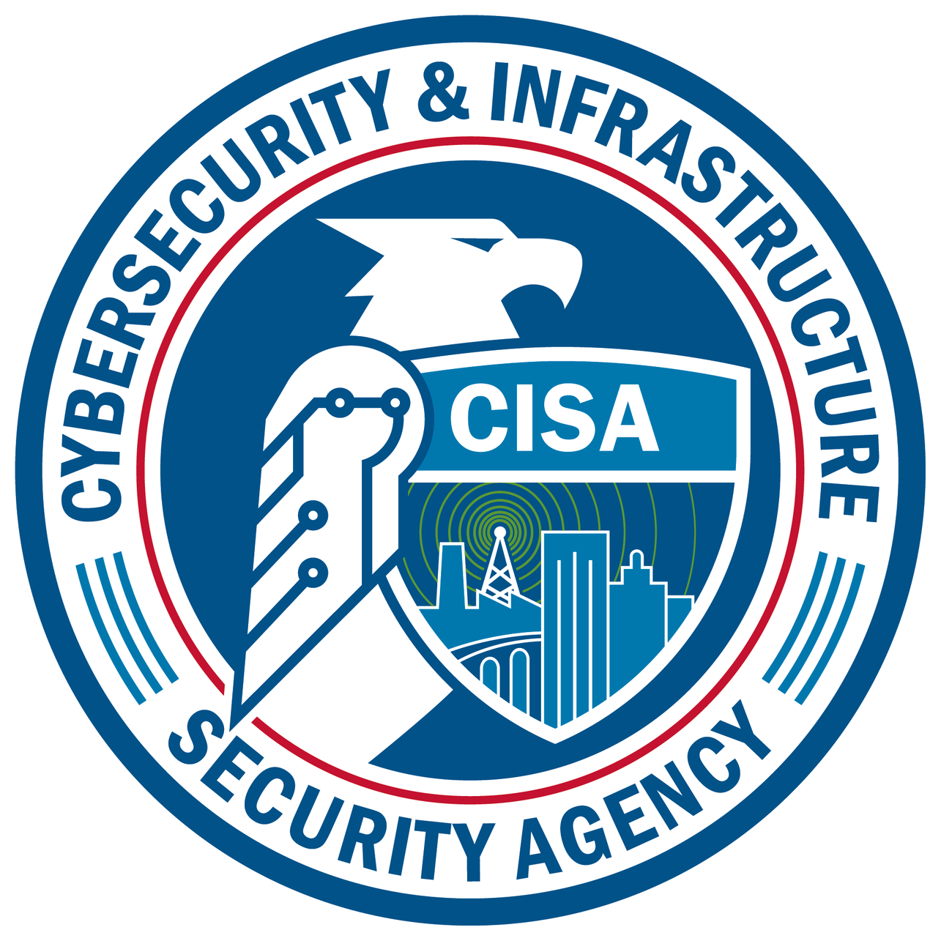















Who is SAFECOM?
Notes:
Provide brief overview of SAFECOM Associations (see notes below for reference)
SAFECOM uniquely brings together over 60 representatives from state, local, tribal, and territorial emergency responders, appointed and elected officials, and major intergovernmental and national public safety associations. SAFECOM’s membership also coordinates other elected and appointed officials and key emergency communications stakeholders to provide input on the challenges, needs, and best practices facing emergency communications
SAFECOM also works to collaborate and educate elected and appointed officials and other key emergency communications stakeholders, gaining insightful information on communications challenges across the Nation and providing input on lessons learned and best practices to the public safety community.

Slide 6
SAFECOM Standing Committees
SAFECOM creates working groups and task forces to develop on defined product or execute one specific activity. Current SAFECOM working groups and task forces and their alignment are as follows:
SAFECOM Executive Board
Communications Section Task Force
Incident Communications Advisory Council (ICAC)
Information Sharing Framework Task Force
Project 25 Compliance Assessment Program (CAP) Task Force
Project 25 User Needs Task Force
Governance Committee
Funding & Sustainment Committee
Technology Policy Committee
Education and Outreach Committee
Membership Working Group
Cybersecurity Working Group
Working Group
ICAM Sub-Working Group
Next Generation 911 (NG911) Working Group
Notes:
SAFECOM working groups are composed of members from and report to their respective committees
SAFECOM task forces are composed of members from across SAFECOM and report to the SAFECOM Executive Board

Slide 7
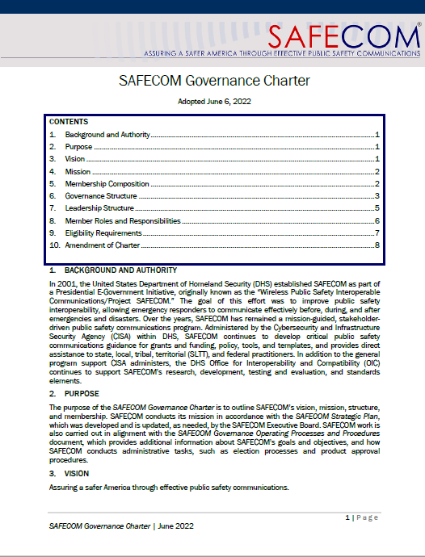

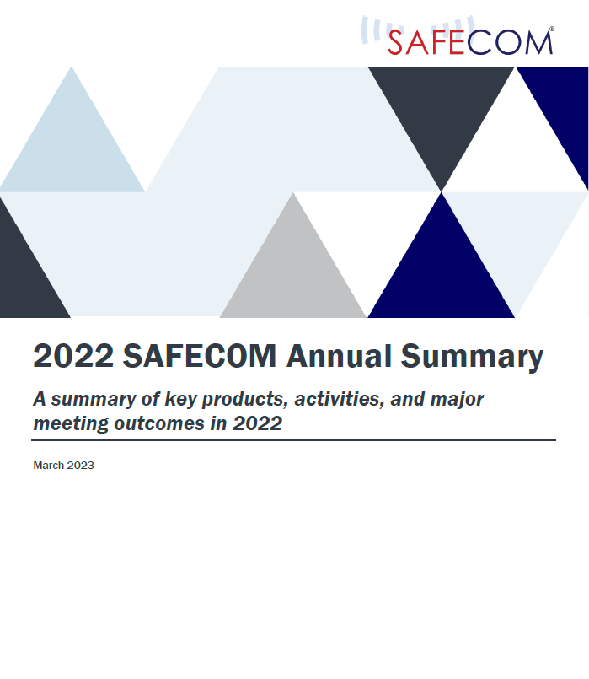
Governance Committee
Focuses on public safety communications governance, which concentrates on improving both SAFECOM governance structures and processes as well as external statewide governance bodies for public safety communications
Manages SAFECOM’s membership and develops programmatic resources
SAFECOM Governance Charter
SAFECOM Strategic Plan
SAFECOM Annual Report

Slide 8

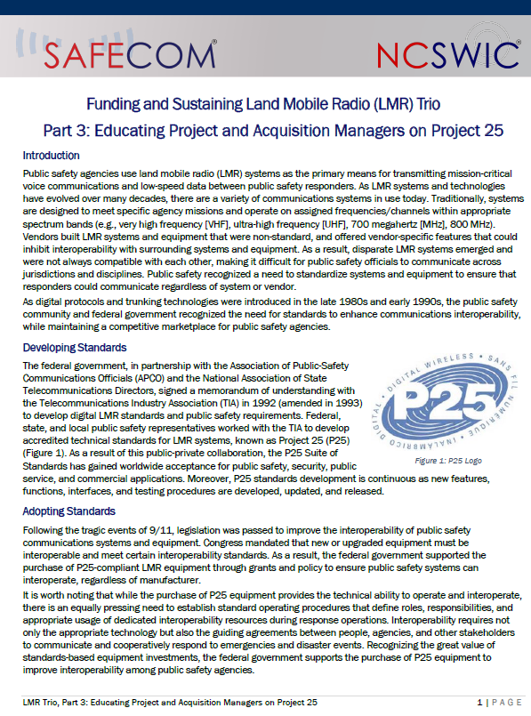
Funding & Sustainment Committee
Concentrates on identifying innovative means to fund and sustain emergency communications systems and activities
Prepares and disseminates information on appropriations and new funding sources available to the public safety community at all levels of government
SAFECOM Guidance on Emergency Communications Grants
Funding and Sustaining Land Mobile Radio (LMR) Trio

Slide 9
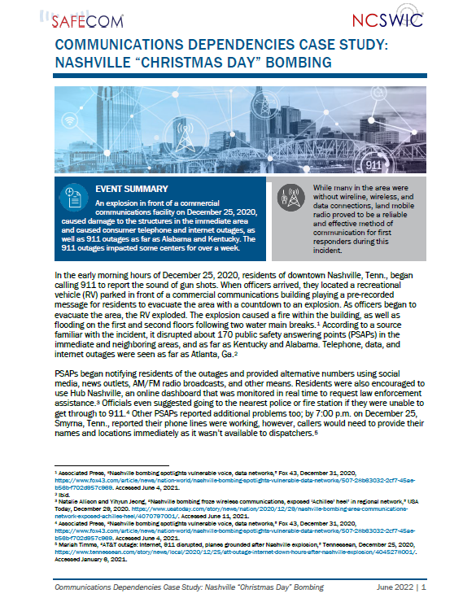
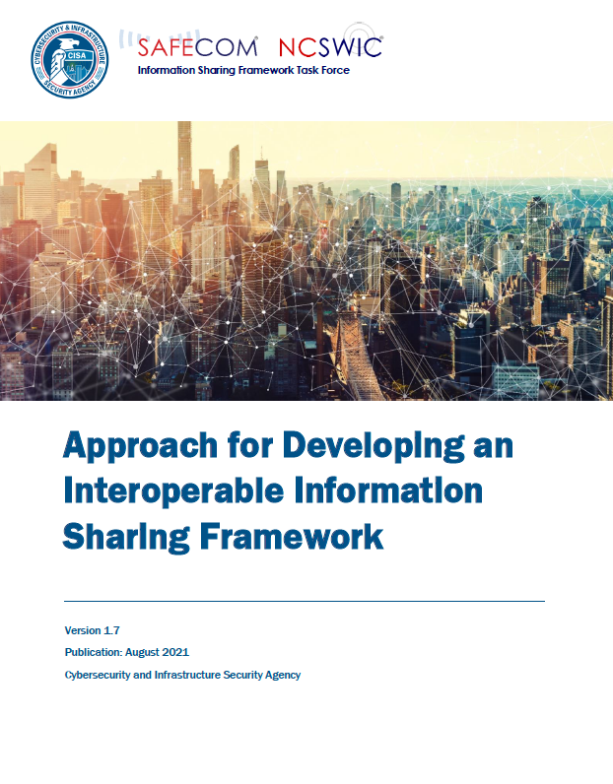
Technology Policy Committee
Promotes technologies, resources, and policies related to emergency communications and interoperability
Continues to support LMR, promote broadband technology deployment, and partner with other federal groups to further the use and security of emergency communications systems
Communication Dependencies Case Study: Nashville Bombing
Approach for Developing an Interoperable Information Sharing Framework

Slide 10
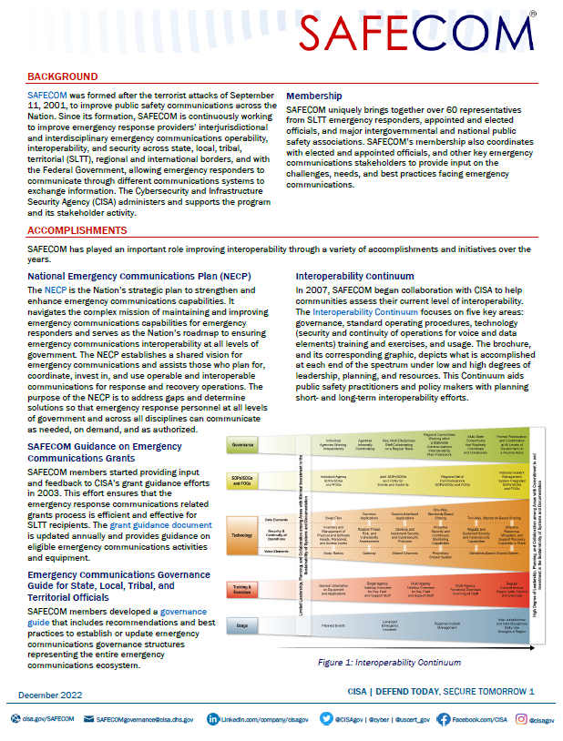
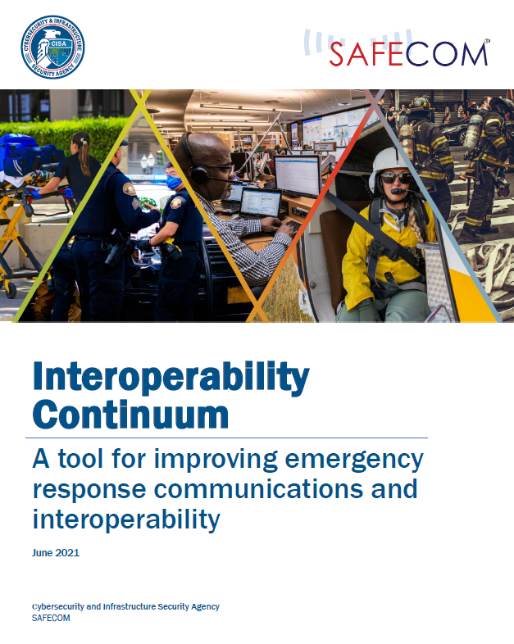
Education & Outreach Committee
Promotes the role of SAFECOM and highlights its impact on emergency communications nationwide
Leads SAFECOM’s efforts with member and non-member organizations to best communicate SAFECOM’s mission, goals, and priorities
SAFECOM Factsheet
Interoperability Continuum

Slide 11



SAFECOM Executive Board
SAFECOM is headed by the SAFECOM Executive Board
The 11-member board is responsible for providing strategic leadership to SAFECOM and approving SAFECOM’s array of products
SAFECOM Executive Board
Chair
First Vice Chair
Second Vice Chair
Committee Chairs (4)
Governance, Education & Outreach, Funding & Sustainment, Technology Policy
Board Members (4)
Elected by SAFECOM Membership; Open to association and At-Large members

Slide 12
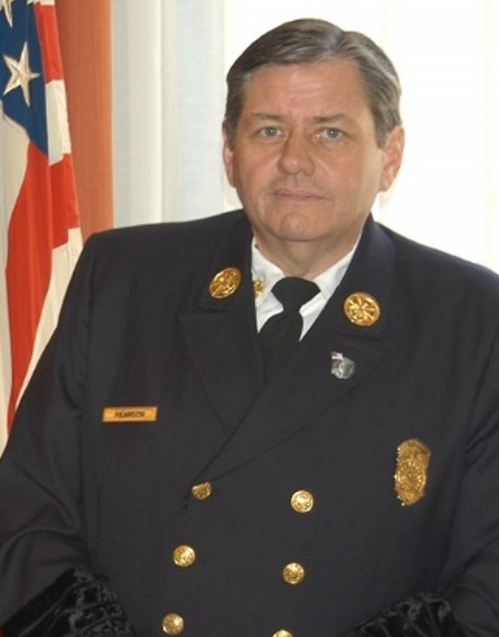
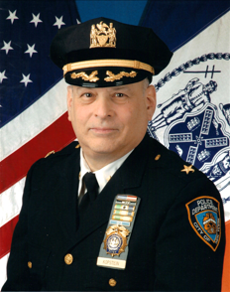
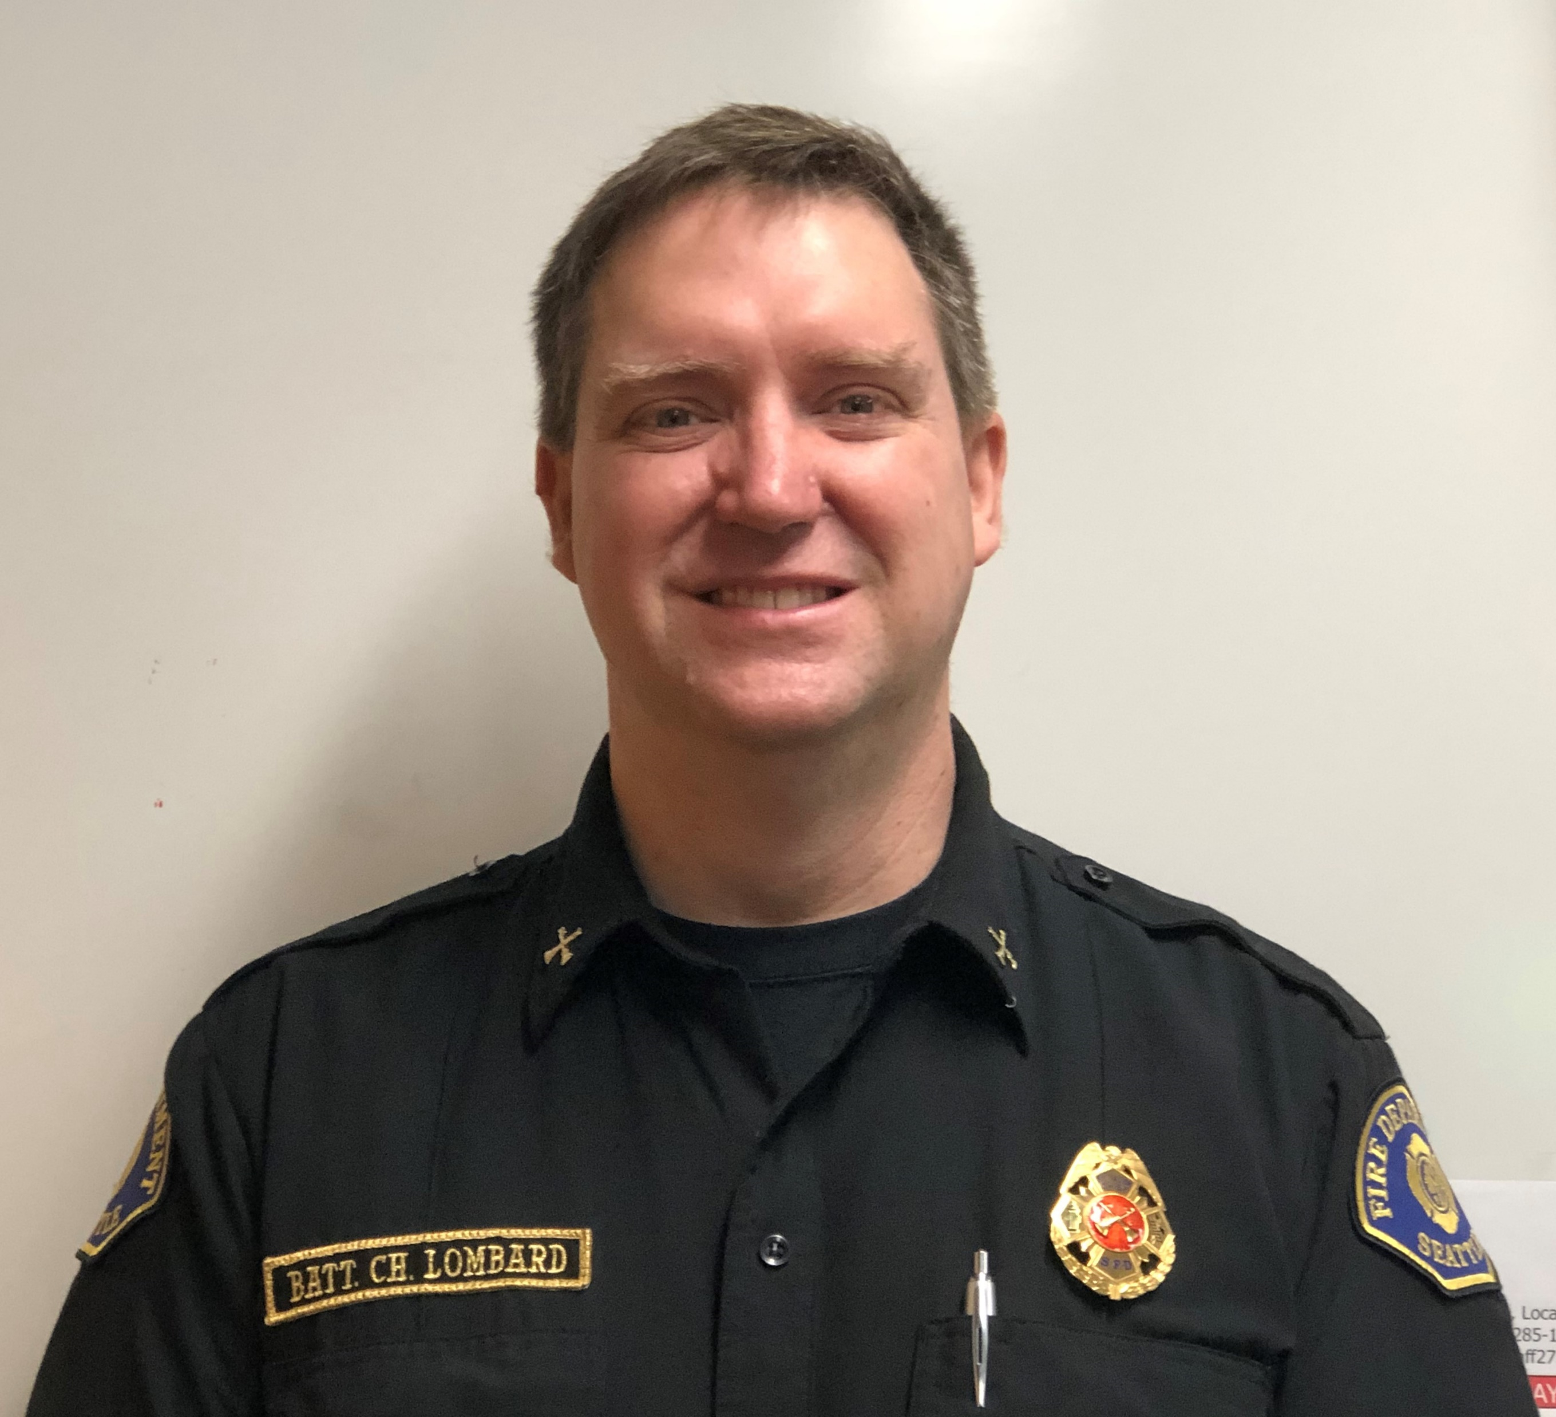
SAFECOM Leadership
SAFECOM Chair
Chief Gerald Reardon
First Vice Chair
Chief Chris Lombard
Second Vice Chair
Chief Jay Kopstein
SAFECOM At-Large (City of Cambridge, Massachusetts, Fire Department)
The Interagency Board for Emergency Preparedness & Response (IAB); SAFECOM At-Large (Seattle, Washington Fire Department)
SAFECOM At-Large (New York State Division of Homeland Security and Emergency Services)
Notes:
NOTE: Chief Reardon and Chief Kopstein are retired from their active public safety posts

Slide 13

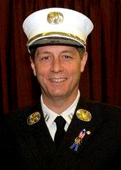
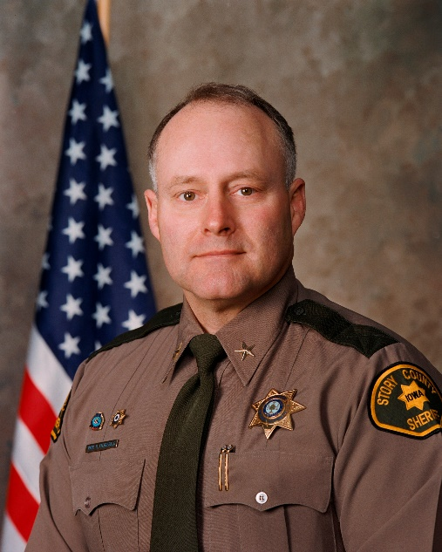

SAFECOM Leadership
SAFECOM Board Members
Chief Doug Aiken
Anthony Catalanotto
Sheriff Paul Fitzgerald
Charlie Sasser
National Public Safety Telecommunications Council (NPSTC)
SAFECOM At-Large (New York State Division of Homeland Security & Emergency Services)
National Sheriffs’ Association (NSA)
National Association of State Technology Directors (NASTD)
Notes:
NOTE: Chief Aiken and Anthony Catalanotto have retired from their active public safety posts

Slide 14
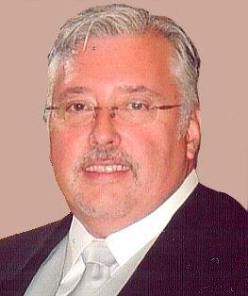
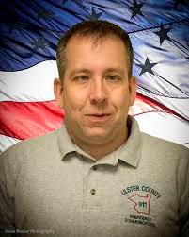
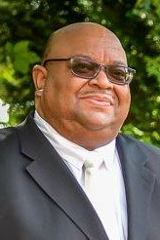
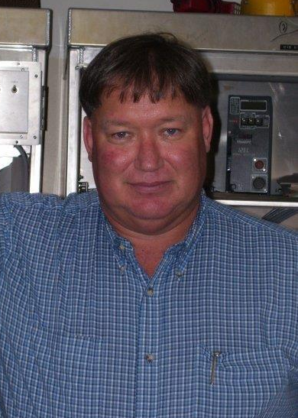
SAFECOM Leadership
SAFECOM Committee Chairs
Governance
Major George Perera
Education & Outreach
Michael Davis
Funding & Sustainment
Lloyd Mitchell
Technology Policy
Philip Mann
SAFECOM At-Large (Miami-Dade Police Department)
SAFECOM At-Large (Ulster County 911 Emergency Communications )
Forestry Conservation Communications Association (FCCA)
American Public Works Association (APWA)

Slide 15
SAFECOM Resources
    Email
    SAFECOMGovernance@cisa.
    dhs.gov
    Website
    cisa.gov/SAFECOM
    Blog
    cisa.gov/SAFECOM/blog
    Membership
    cisa.gov/safecom/membership
    Funding Products cisa.gov/safecom/funding
    Technology Products cisa.gov/technology
    Governance Products
    cisa.gov/safecom/governance
    Planning Products
    cisa.gov/safecom/planning
Notes:
[Emphasize the push toward providing electronic resources for practitioners and decisions makers through the SAFECOM website, including resources created by the committees.]

Slide 16
SAFECOM Resources
    LinkedIn
    Linkedin.com/company/cisagov
    Twitter
    @cisagov
    Facebook
    Facebook.com/cisa
    Instagram
    @cisagov
Notes:
[Emphasize the push toward providing electronic resources for practitioners and decisions makers through the SAFECOM website, including resources created by the committees.]

Slide 17
For more information:
cisa.gov/safecom
Questions?
Email:
SAFECOMGovernance@CISA.DHS.GOV

